Slide 1
User Experience Modeling for DASH Video
Yao Liu , Sujit Dey (UCSD)
Don Gillies, Faith Ulupinar, Michael Luby (Qualcomm)
Dec 12, 2013
Notes:
Good morning, everyone. My name is Yao Liu, I am a graduate student of UC San Diego. Today the topic of my presentation is User Experience Modeling for DASH Video. This research is a joint work between our research work and Qualcomm.

Slide 2




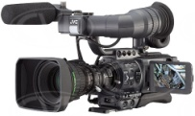


Introduction of DASH video
DASH (dynamic adaptive streaming over HTTP) is a new standard for streaming media using standard web servers.
The video bit rate/quality is adapted according to the network condition.
1
Split the video into small segments
2
Encode each segment at multiple bitrates
5
Client splices together and plays back
001010100001010
010101010001110
01110100011010101
3
Make each segment addressable via a HTTP-URL
001010100001010
010101010001110
01110100011010101
001010100001010
010101010001110
01110100011010101
001010100001010
010101010001110
01110100011010101
4
Client makes decision on which segment to download
Media Capture & Encoding
Media Origin Servers
HTTP Cache Servers
Devices
Notes:
As we all know, DASH is a new standard of adaptive video streaming where during a streaming session, video quality will dynamically change according to the network condition . As shown in this figure, on the server side, the video content are splitted into short segments, and each segments have been encoded into several different versions. And on the mobile device side, the DASH client will keep monitoring the network and decide which segment to download according to the current network condition.

Slide 3
Introduction of DASH video (2)
DASH video source are pre-encoded into several levels, split into short segments, and stored in Web sever.
Level | Bit Rate (kbps) | Resolution | Frame Rate
1 | 400 | 312 x176 | 15
2 | 600 | 400 x 224 | 15
3 | 900 | 512 x 288 | 15
4 | 950 | 544 x 304 | 15
5 | 1250 | 640 x 360 | 25
6 | 1600 | 736 x 416 | 25
7 | 1950 | 848 x 480 | 25
8 | 3450 | 1280x720 | 30
Encoding settings for streaming Vancouver Olympics
How to quantitatively measure the user experience of DASH video streaming?
Notes:
This table shows an example of how DASH video content are prepared. It is the encoding setting used for streaming Vancouver Olympic games, we can see that the video content are encoded into 8 levels, from low bit rate to high bit rate. And each bit rate has a resolution and frame rate associated with it.
So you may wonder, given that the during a streaming session, the video quality will be adapted in realtime, so how to quantitative measure the user experience, and that is the problem we are trying to solve.

Slide 4
Factors affecting User Experience for DASH video streaming
We conducted subjective experiments to derive impairment function for each of these factors
Notes:
The first step for studying DASH video user experience is to identify all the factors that affect it. As shown in this figure, we will focus on 3 factors. The first factor is initial delay, which indicates the initial loading time before the video really start playing. The second factors is stall, which means the rebuffering event during a streaming session. Within the stall factor, we also consider two dimensions which is the total stall duration and the number of stalls, which captures the amount of time of rebuffering and frequency of rebuffering.
The last factor we are interested in is called level variation. By level, we mean the combination of bit rate, resolution and frame rate. We also consider 3 dimensions with this factors: …. We believe that for DASH video, it is not just the level itself will affect user experience, the level variation pattern, including the how frequent and how large magnitude the bit rate is changing, wills also impact user experience.
In this work we will conduct subjective quality assessment experiment to xxxxxx.

Slide 5
Factors affecting User Experience(2)
There are also other factors that affect UE: such as video length, amount of motion in video. However, in this study, we focus on medium motion, short video (about several minutes long).
Notes:
We also want to clarify that xxxxx.

Slide 6
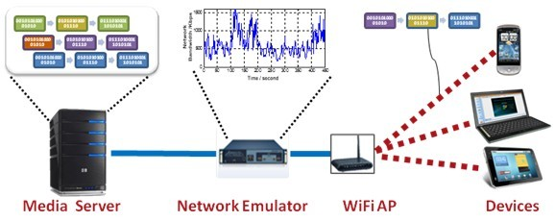
DASH Video Streaming Characterization Experiment (1)
Before doing subjective test, we conduct a set of characterization experiment (streaming DASH video under various mobile network conditions), to understand and characterize how DASH adaptation algorithm will behave.
Testbed of DASH video streaming characterization experiment.
We have tested under 20 Cellular network traces. The video length we choose is 2 minutes.
Among the 20 traces, average bandwidth ~ [750, 1850] kbps, network latency ~ [0, 100] ms, packet loss rate ~ [0%, 1%].
Notes:
Before doing subjective test, we conduct a set of characterization experiment (streaming DASH video under various mobile network conditions), to understand and characterize how DASH adaptation algorithm will behave.
This figure shows the testbed we used for this experiments, the Media Server is connected to the mobile device through a network emulator. We can program this network emulator to control the bandwidth trace. We have totally tested 20 different Cellular network traces, which exhibit a wide variaty of network conditions. For each streaming session, we record the values of the 3 factors we are interested. Through this set of streaming experiment, we want to characterize the distribution of the 3 factors, and use this distribution as a guidance for deriving our subjective test videos.

Slide 7
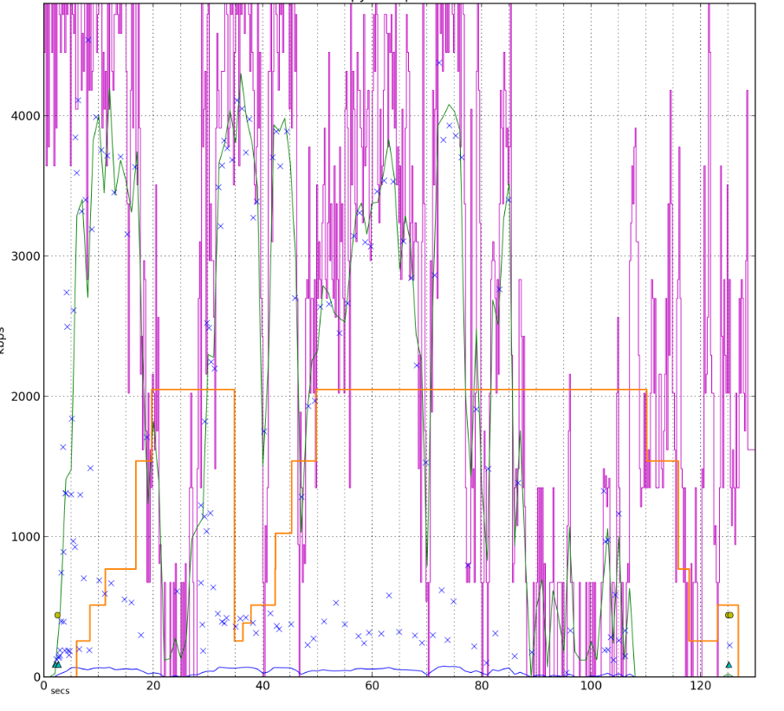
DASH Video Streaming Characterization Experiment (2)
Sample plot of experiment result
(1) purple curve: network bandwidth; (2) green curve: segments download bit rate; (3) orange curve: video bit rate.

Slide 8
Distribution of factors: initial delay and stall
Initial Delay (second)

Slide 9
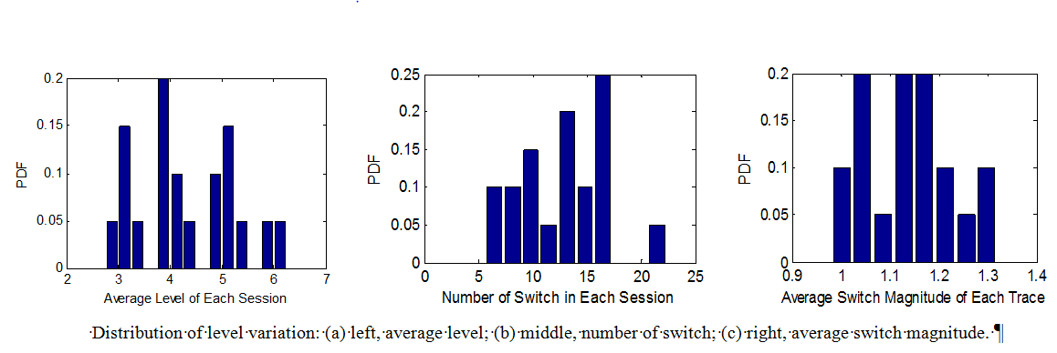
Distribution of factors: level variation
We will develop test videos for subjective experiments according to the distribution of the factors.
However, we will also include test videos whose characteristics are outside of what was observed in the DASH characterization tests, to ensure we also cover more extreme cases.

Slide 10

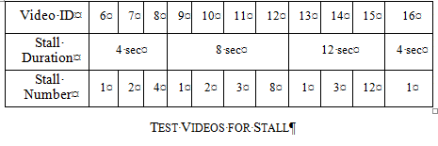

Test Videos for Subjective Experiment
In subjective experiment, we aim at deriving impairment function for each factor (initial delay, stall and level variation), therefore we generate test video including impairment caused by these factors.
In each test case, we only vary one factor, and keep the other two factors at their best values.
Video source we used for subjective experiment.

Slide 11
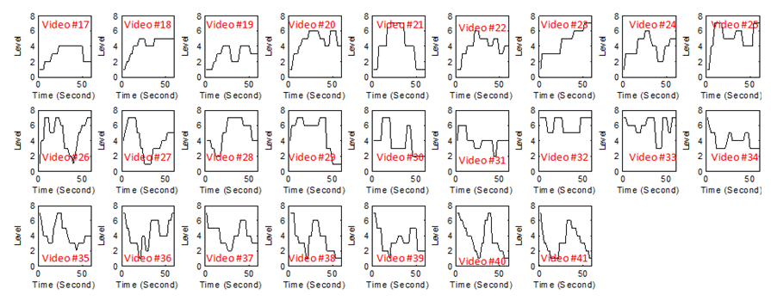
Test Videos for Subjective Experiment (2)
Test Videos for Level Variation, including 25 different level variation patterns.
Notes:
Including video bit rate starts from high and ends in low, starts from low and ends high low level. And also xxxx.

Slide 12
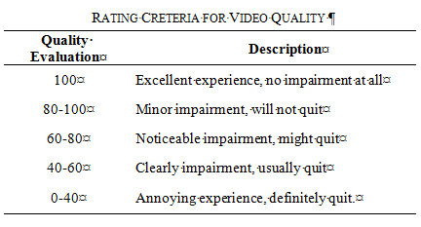
Subjective Experiment
30 subjects from UCSD, with age ranges from 18 to 28, were selected for the study.
They watched the designed DASH test videos (with impairment caused by the 3 factors) in a lab environment, and gave individual evaluation about the perceived video quality with a 100 point quality scale.
A Qualcomm MSM8960 tablet with 1280x768 display resolution is used to watch the test videos.

Slide 13
Results of Impairment Function I_{ID}
Initial delay
L_{ID:} Length of Initial Delay (second)
Notes:
This figure shows the relationship between the initial delay and the people’s average evaluation about the impairment.

Slide 14
Results of Impairment Function I_{ST}
Stall
Video ID | 6 | 7 | 8 | 9 | 10 | 11 | 12 | 13 | 14 |  | 15
Stall Duration | 4 sec |  |  | 8 sec |  |  |  | 12 sec
Stall Number | 1 | 2 | 4 | 1 | 2 | 3 | 8 | 1 |  | 3 | 12
Impairment Value | 16.5 | 21.8 | 31.3 | 31.1 | 27.3 | 33.3 | 47.5 | 40.8 |  | 37.5 | 58.5
D_{ST:} Total Duration of Stall
a | b | c
3.8 | 4.2 | 2.6
N_{ST}: Number of Stall
Notes:
This table list at different stall duration and stall numbers, what are people’s evalation about the impairment. The take away from this table is that a lot of short stall is the most annoying to people, followed by a very long stall, and a certain number of medium stall is the most acceptabe artifacts.
Therefore, if the total stall duration is fixed, the impairment will not be a monotonic increasing function of … we cannot use a linear function to .

Slide 15
Results of Impairment Function I_{LV}
Level Variation
Different service providers may encode/prepare DASH video using different settings. In order to ensure that I_{LV} is generally applicable, instead of using ‘Level‘, we use VQM_{i} to indicate the visual quality of a encoded DASH segment i.
Impairment caused by low bit rate itself
Impairment caused by bit rate change
VQM_{i:} VQM (objective video frame quality) for segment i
T: the length of each segments (second)
D_{i}: the number of continuous segments right before segment i that have VQM value within range: [VQM_{i}-µ, VQM_{i}+µ ].
k | B₁ | B₂ | µ
0.02 | 75.6 | 48.2 | 0.05
Notes:
The last one is xxx. Remember that we have collected people’s evaluation for 25 different level variation patterns. As we anaylize the data we collected, we have the following observation. We find that the amount of annoyness that people feel actually come from 2 parts, the first part is due to the low bit rate itself, and the other part is due to the bit rate swicth (including the frequency and magnitude of switch). And the first part, the impairment due to low bit rate itself, we also observe that if the bit rate only stays at a low level for 2 3 seconds and rebound, people will be OK with that, but if video bit rate stays low xxxx for 10, 15 second, people will be very disappointed with that. We claim that the anooyness will increase exponentially with the duration we stay at a low level.
The second xxx.

Slide 16
Summary
Identify 3 factors that affect DASH video streaming user experience
Conduct DASH video streaming characterization experiment to obtain the range and distributions of these 3 factors
Conduct subjective quality assessment experiment to derive impairment functions for these 3 factors
In the future, we will conduct another round of subjective experiment to combine the 3 impairment functions together to form an overall user experience model.

Slide 17

Questions
Thanks !

Slide 18
Backup (1)
VQM is a widely accepted video quality metric. It take value between [0, 1]. High VQM stands for lower quality.
It cannot be directly applied to DASH video because it doesn’t include quality variation.
An example of the relationship between VQM value and bit rate

Slide 19
Backup (2)
Impairment caused by low bit rate itself
Impairment caused by bit rate change
D_{i}: the number of continuous segments right before segment i that have VQM value within range: [VQM_{i}-µ, VQM_{i}+µ ].
Why define D_{i} like this ???
Considering the situation where bit rate keeps switching between 2 very close values .

Slide 20
Backup (3)
D_{i}: the number of contiguous segments right before segment i that have VQM value within range: [VQM_{i}-µ, VQM_{i}+µ ].
The way to compute D_{i:}: from segment i, count to the left, until reaching the first segment that is not at almost the same level as segment i, then the counted number will be D_{i}.
Bit Rate
For example, for this segment, there are totally 6 continuous segments on its left && adjacent to segment i that are almost at the same level with it. Therefore its Di value is 6.
Time
D_{i}
0
0
1
2
3
4
5
6
0
1
2

Slide 21
Backup (4)

